Slide 1
CS 105 DATA ANALYSIS METHODS

Slide 2
Outline
Data Science
Introduction
Why Data Science
Data Scientists
What do they do?
Course Logistics

Slide 3
Introductions …
Course Instructor
Prof. Mariam Salloum
Email: msalloum@cs.ucr.edu
Webpage: www.cs.ucr.edu/~msalloum
Available after class for office hours, but you can always setup an appointment for a time that works for you.
Lab Instructor / TA
Haochen Zeng Email: hzeng013@ucr.edu

Slide 4
What is Data Science?
An area that manages, manipulates, extracts, and interprets knowledge from tremendous amount of data
Data science (DS) is a multidisciplinary field of study with goal to address the challenges in big data
Data science principles apply to all data – big and small
https://hbr.org/2012/10/data-scientist-the-sexiest-job-of-the-21st-century/

Slide 5
What is Data Science?
Theories and techniques from many fields and disciplines are used to investigate and analyze a large amount of data to help decision makers in many industries such as science, engineering, economics, politics, finance, and education
Computer Science
Pattern recognition, visualization, data warehousing, High performance computing, Databases, AI
Mathematics
Mathematical Modeling
Statistics
Statistical and Stochastic modeling, Probability.

Slide 6
Big Data and Data Science
“… the sexy job in the next 10 years will be statisticians,” Hal Varian, Google Chief Economist
The U.S. will need 140,000-190,000 predictive analysts and 1.5 million managers/analysts by 2018. McKinsey Global Institute’s June 2011
New Data Science institutes being created or repurposed – NYU, Columbia, Washington, UCB,...
New degree programs, courses, boot-camps:
at most UCs, including UCR!!!
There are numerous MS programs as well
There are alot of internships and research opportunities:
Check this out: http://www.dssgfellowship.org

Slide 7
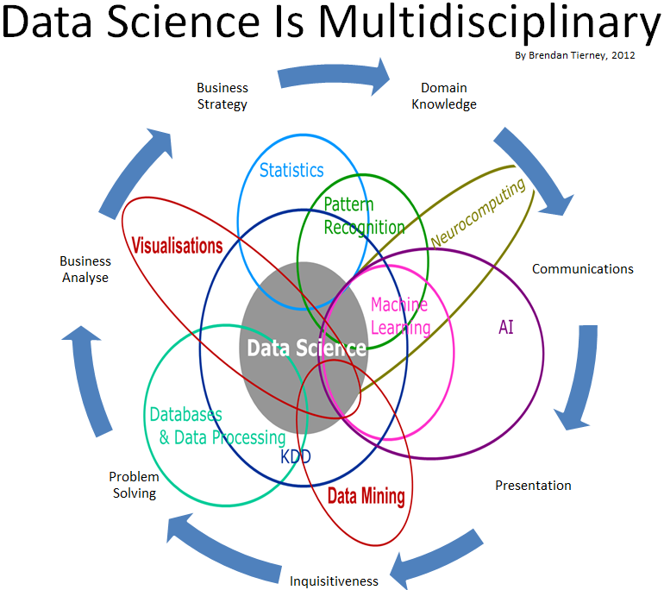
Data Science

Slide 8
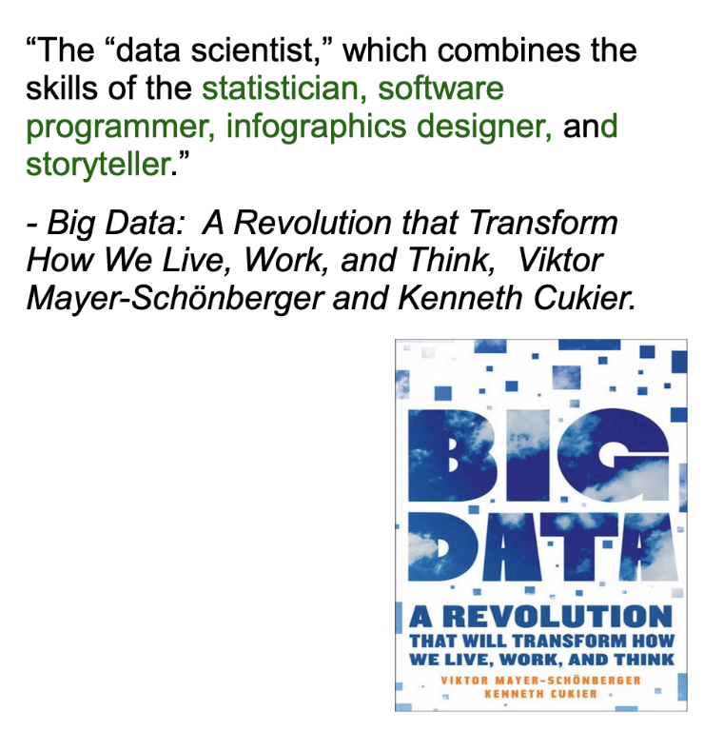
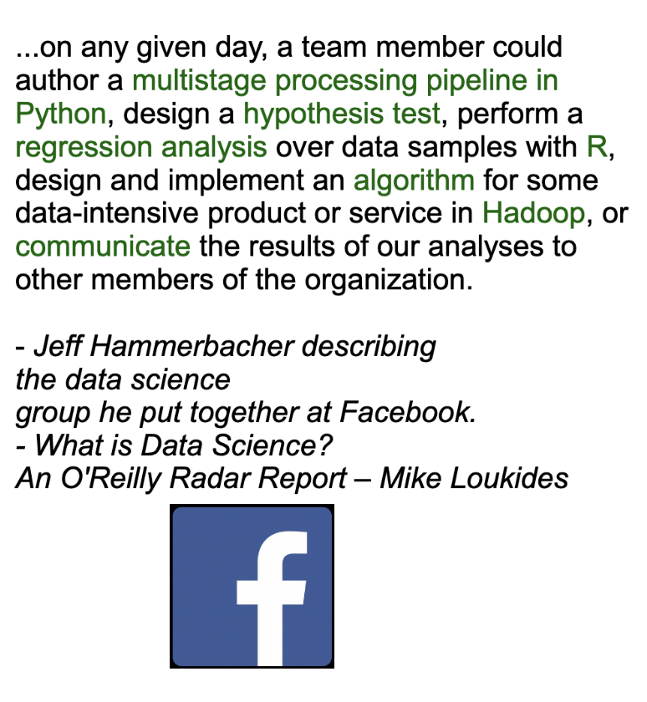
What is Data Science?

Slide 9

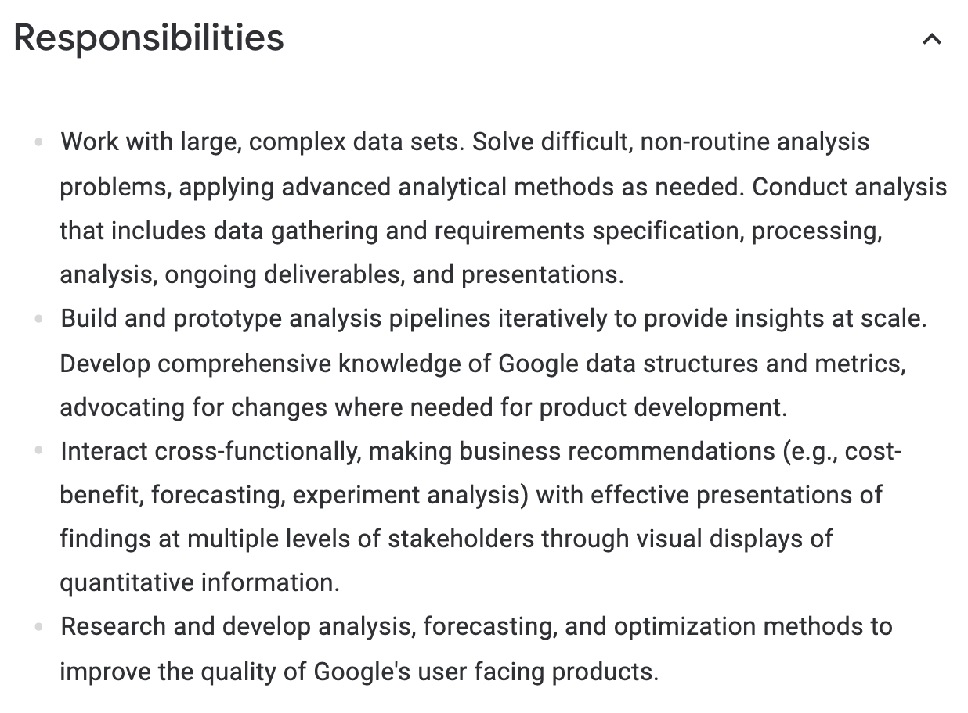
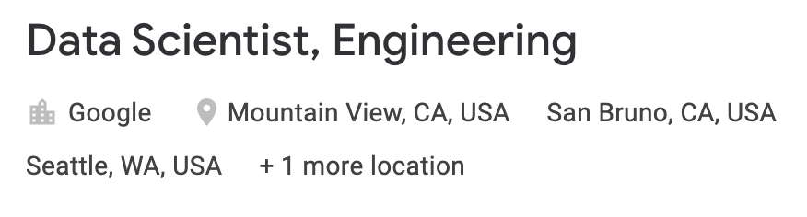
What is Data Science?

Slide 10
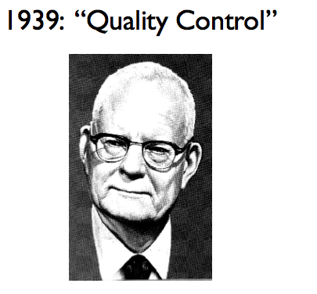
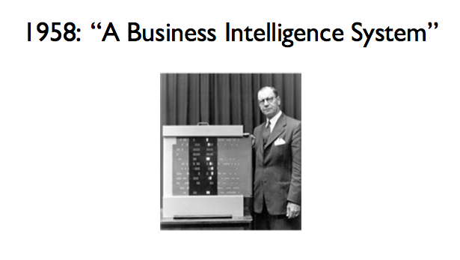
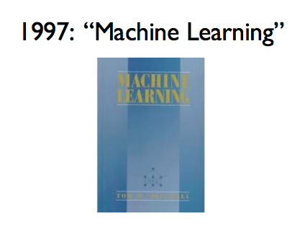
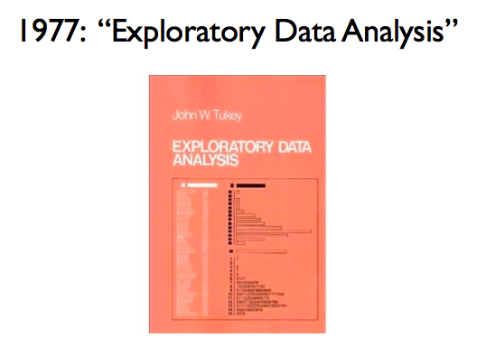
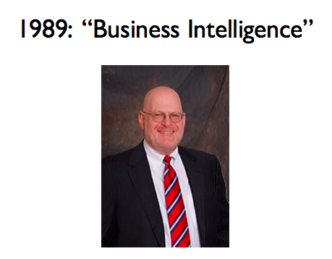
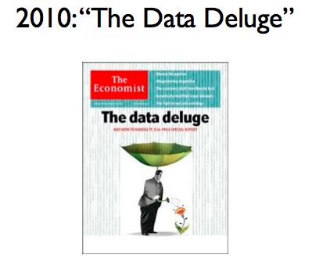
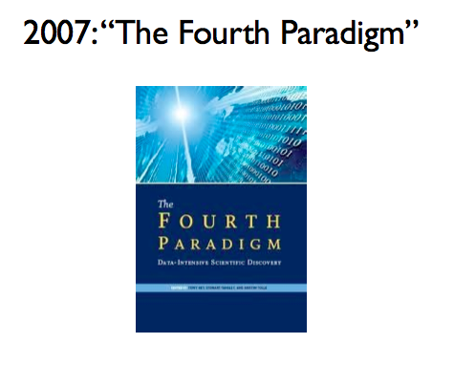
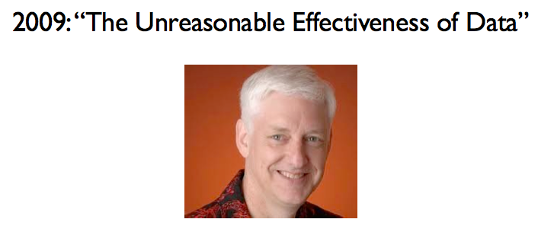
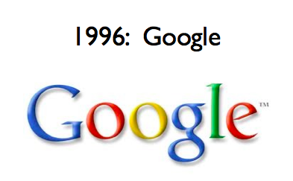
Data Analysis Has Been Around for a While…
R.A. Fisher
W.E. Deming
Peter Luhn
Howard
Dresner
Notes:
Fisher: ANOVA (analysis of variance: a collection of statistical models, used to analyze the differences among group means and their associated procedures (such as "variation" among and between groups)), Fisher’s exact test.
Also credited with quote “correlation does not imply causation” – lifetime pipe smoker, he derided papers showing a link between smoking and cancer.
Deming – quality control – statistical sampling
Luhn – indexing, IR principles – use text and data to inform Business Decisions
Tukey – exploratory data analsysis – led to S, S+ and R
Howard Dresner – modern proponent of BI
Tom Mitchell’s ML book – still a best-seller
Fourth Paradigm – data driven scientific discovery – inspired by Jim Gray’s work at MSR. His primary research interests are in databases and transaction processing systems -- with particular focus on using computers to make scientists more productive. He and his group are working in the areas of astronomy, geography, hydrology, oceanography, biology, and health care.
Other scientific discovery paradigms: empiricism, analysis and simulation
Google Inc 🡪 alphabet Inc. Google began in January 1996 as a research project by Larry Page and Sergey Brin when they were both PhD students at Stanford University in Stanford, California.^{[33]}
Peter Norvig – simple models + lots of data > complex models
Data Deluge – exponential growth in data volume, the Economist 2010, Businesses, governments and society are only starting to tap its vast potential

Slide 11
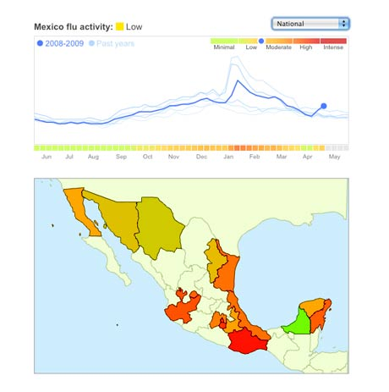
Data Science: Why all the Excitement?
Exciting new effective
applications of data analytics
e.g.,
Google Flu Trends:
Detecting outbreaks
two weeks ahead
of CDC data
New models are estimating which cities are most at risk for spread of the Ebola virus.
Prediction model is built on
Various data sources,
types and analysis.
Notes:
CDC: Centers for Disease Control

Slide 12
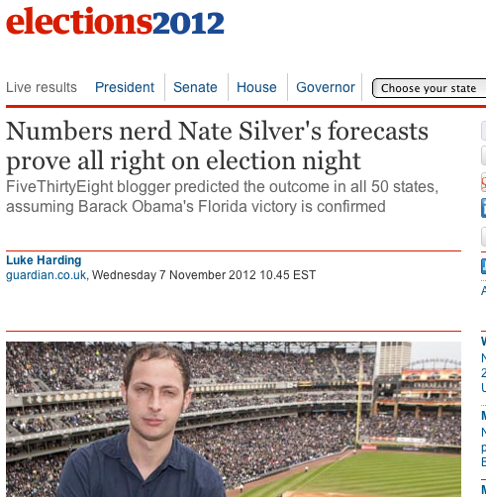
Why the all the Excitement?

Slide 13
Data and Election 2012 (cont.)
…that was just one of several ways that Mr. Obama’s campaign operations, some unnoticed by Mr. Romney’s aides in Boston, helped save the president’s candidacy. In Chicago, the campaign recruited a team of behavioral scientists to build an extraordinarily sophisticated database
…that allowed the Obama campaign not only to alter the very nature of the electorate, making it younger and less white, but also to create a portrait of shifting voter allegiances. The power of this operation stunned Mr. Romney’s aides on election night, as they saw voters they never even knew existed turn out in places like Osceola County, Fla.
-- New York Times, Wed Nov 7, 2012
The White House Names Dr. DJ Patil as the First U.S. Chief Data Scientist, Feb. 18th 2015

Slide 14
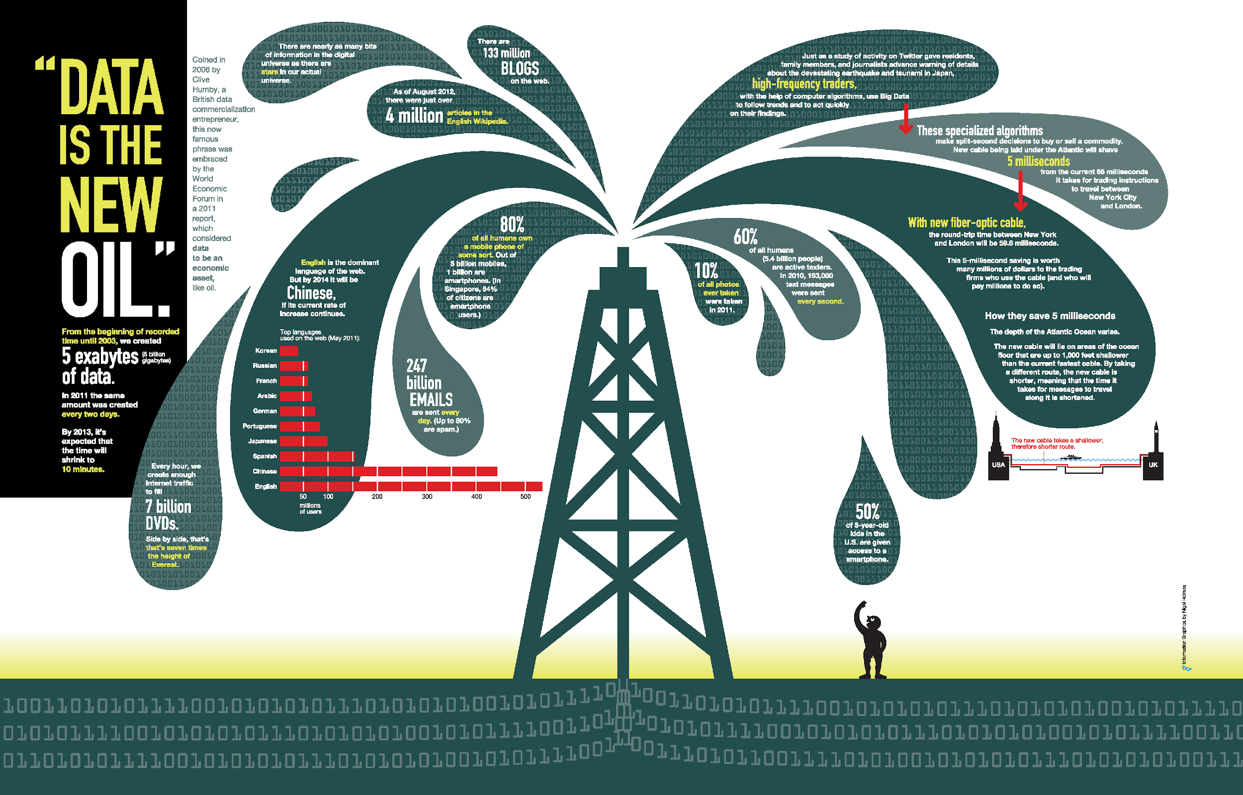
“Data is the New Oil” – World Economic Forum 2011
Notes:
“Data is the new oil." Coined in 2006 by Clive Huby, a British data commercialization entrepreneur, this now famous phrase was embraced by the World Economic Forum in a 2011 report,
All human generated information up to 2003 is 5 exabytes. Same amount of data was generate every 2 days in 2011 and would be every 10 min NOW.
Data is just like crude oil. It’s valuable, but if unrefined it cannot really be used. It has to be changed into gas, plastic, chemicals, etc to create a valuable entity that drives profitable activity; so must data be broken down, analyzed for it to have value.

Slide 15

Data Science – A Definition
Data Science is the science which uses computer science, statistics and machine learning, visualization and human-computer interactions to collect, clean, integrate, analyze, visualize, interact with data to create data products.

Slide 16


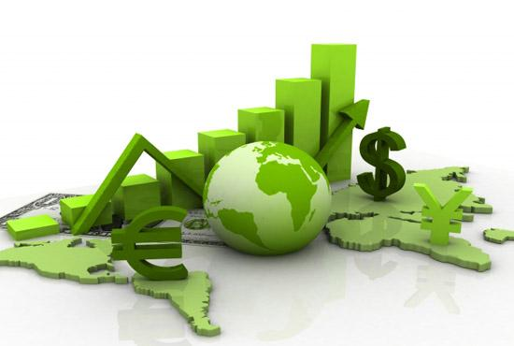

Data All Around
Lots of data is being collected and warehoused
Web data, e-commerce
Financial transactions, bank/credit transactions
Online trading and purchasing
Social Network

Slide 17
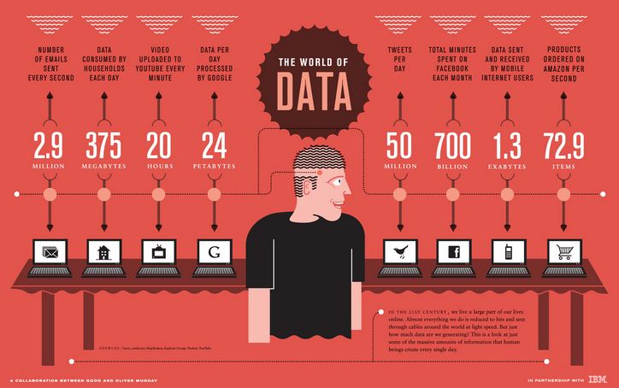
How Much Data Do We have?
Google processes 20 PB a day (2008)
Facebook has 60 TB of daily logs
eBay has 6.5 PB of user data + 50 TB/day (5/2009)
1000 genomes project: 200 TB
Cost of 1 TB of disk: $35
Time to read 1 TB disk: 3 hrs
(100 MB/s)

Slide 18
Big Data
Big Data is any data that is expensive to manage and hard to extract value from
Volume
The size of the data
Velocity
The latency of data processing relative to the growing demand for interactivity
Variety and Complexity
the diversity of sources, formats, quality, structures.

Slide 19
Types of Data We Have
Relational Data (Tables/Transaction/Legacy Data)
Text Data (Web)
Semi-structured Data (XML)
Graph Data
Social Network, Semantic Web (RDF), …
Streaming Data
You can afford to scan the data once

Slide 20
Logistics
Class Attendance is expected !
Lectures
Class will meet MW 10:00 AM - 12:50 PM
Lectures will include PPT slides and examples in Juypter notebooks
Labs
M/W 02:00 PM - 04:50 PM

Slide 21

Course Logistics (1/2)
Make sure you can login to iLearn, and access this course.
Lets go over the syllabus …
We will use the following tools to manage the course:
iLearn : Will be used to turn-in programming assignments and post grades
CampusWire: Will be used for class discussions. We will enroll everyone to the course discussion page on the 2nd week of classes, or you can enroll yourself via code.
Google Drive: Will use a shared drive to post lecture slides, labs, reading material, solutions, etc. Be sure to use your UCR email to gain access to the Google drive.

Slide 22
Course Logistics (2/2)
Lets go over the syllabus …
Class is composed of
Labs x 5
Quizzes x 2
Final Project
Labs
We will have a lab assignment each week
Labs will be turned in online and demoed to the TA
You have upto 1 – week to complete the lab assignment. Incomplete labs must be demoed to the TA at the beginning of the next lab session.
Quizzes
We will have quizzes that will be distributed via Gradescope
Final Project
We will have a team-based final project that is composed of several phases.
Phase 1 – project proposal
Phase 2 – data gathering and exploration
Phase 3 – data analysis
Phase 4 – Final report / presentation
Grading
Item | Percentage
Labs | 40%
Quizzes | 35%
Final Project | 25%
Total | 100%

Slide 23
Final Project
The final project is team-based because
Such projects are often team based and its important to learn the skills to communicate and work with others
The final project will be completed in several phases:
Phase 1 – Project Proposal (start this on Week 1)
Find a team member that is excited about the same project idea
Phase 2 – Data Gathering / Exploration
Gather data using a crawler or API
Based on the complexity, you may need to use multiple data sources.
Clean, integrate, and summarize / visualize the dataset
Phase 3 – Preliminary Data Analysis / visualization
Explore the data further and start preliminary analysis using ML techniques
Phase 4 – Presentation
Mini presentation
** Results will be presented as a Juypter notebook **

Slide 24
Suggested Texts
Due to the rapidly evolving nature of the material, there is no single textbook that covers the course in its entirety.
The following textbook covers fundamental concepts for `dealing with data'
Data Science for Business: What You Need to Know about Data Mining and Data-Analytic Thinking, 1st Edition by Foster Provost, Tom Fawcett
Data Mining and Analysis: Fundamental Concepts and Algorithms Mohammed J. Zaki and Wagner Meira Jr
The Wall Street Journal Guide to Information Graphics: The Dos and Dont's of Presenting Data, Facts, and Figures by Dona M. Wong
Doing Data Science: Straight Talk from the Frontline 1st Edition, Kindle Edition by Cathy O'Neil , Rachel Schutt
The class schedule will reference the appropriate reading material for each topic.
Please note, these books are available online via the UCR Library.
Note – you must be on campus or connected via VPN

Slide 25
High level course goals
This course provides an overview of Data Science, covering a broad selection of key challenges in and methodologies for working with big data.
Topics to be covered include:
Data gathering
Data storage
Business intelligence
Basic statistics
Visualization
Data Analysis

Slide 26
High level course goals and learning objectives
Students will acquire a working knowledge of data science through hands-on projects and case studies in a variety of business,, engineering, social sciences, or life sciences domains.
Professional skills, such as
Communication
Presentation
Teamwork,
Storytelling with data, will be fostered

Slide 27
Computing background for the course
Prerequisite: CS 14
You will need to be able to get your hands dirty playing with, processing, and plotting data using Python.
The course will not teach you Python. You should be able to pick-up the syntax through outside readings and practice.
Why Python? It is more commonly used in industry
Kdnuggets Python VS R LINK

Slide 28
What Python skills do we need?
Data exploration/processing
The Python scientific stack
numpy, scipy, pandas, matplotlib
Formatting and presenting results:
JuPyter notebooks

Slide 29
What statistics skills do we need?
Basics:
Estimation
Hypothesis testing
Inference
Applied statistics:
Classification

Slide 30
What other skills do we need?
Combining statistics and programming:
Machine learning
Communicating your results
Use Jupyter Lab and notebooks
Data Visualization
Adapting to different types of data
Evaluating data sets
Cleaning messy data

Slide 31
Python
If you don’t know Python, then this is a good place to start:
Learning Python by Mark Lutz O’Reilly Media, September 2013
Available online via the UCR Library (must be on-campus to access)
We will also be making use of iPython/Jupyter notebooks.
Makes developing Python code easier and sharing / visualizing results
Each student will be given access to a Jupyter notebook

Slide 32
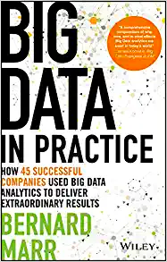
Lets take a look at a few use-cases of data
LINK:
https://ebookcentral.proquest.com/lib/ucr/reader.action?docID=4455265
I suggest you browse the book to look at a few case studies
Select ones that interest you
Bernard Marr

Slide 33
Netflix
How does Netflix use data?
Obviously, Netflix relies on customer data (what customers watch, how long they watch a show, what they search for, etc.) to understand the user’s preferences.
Data is used to build a profile on each customer / user and make recommendations.
In 2007 the Netflix Prize, offering $1M to the group that could come up with the best algorithm predicting how customers would rate a movie based on prior ratings.

Slide 34
Types of Data
Data Science Lifecycle
Types of data :
Tables
Graphs & networks
Time-series
textual data
And go over
simple statistics that describe the data, and
data analysis techniques of each type of data.

Slide 35
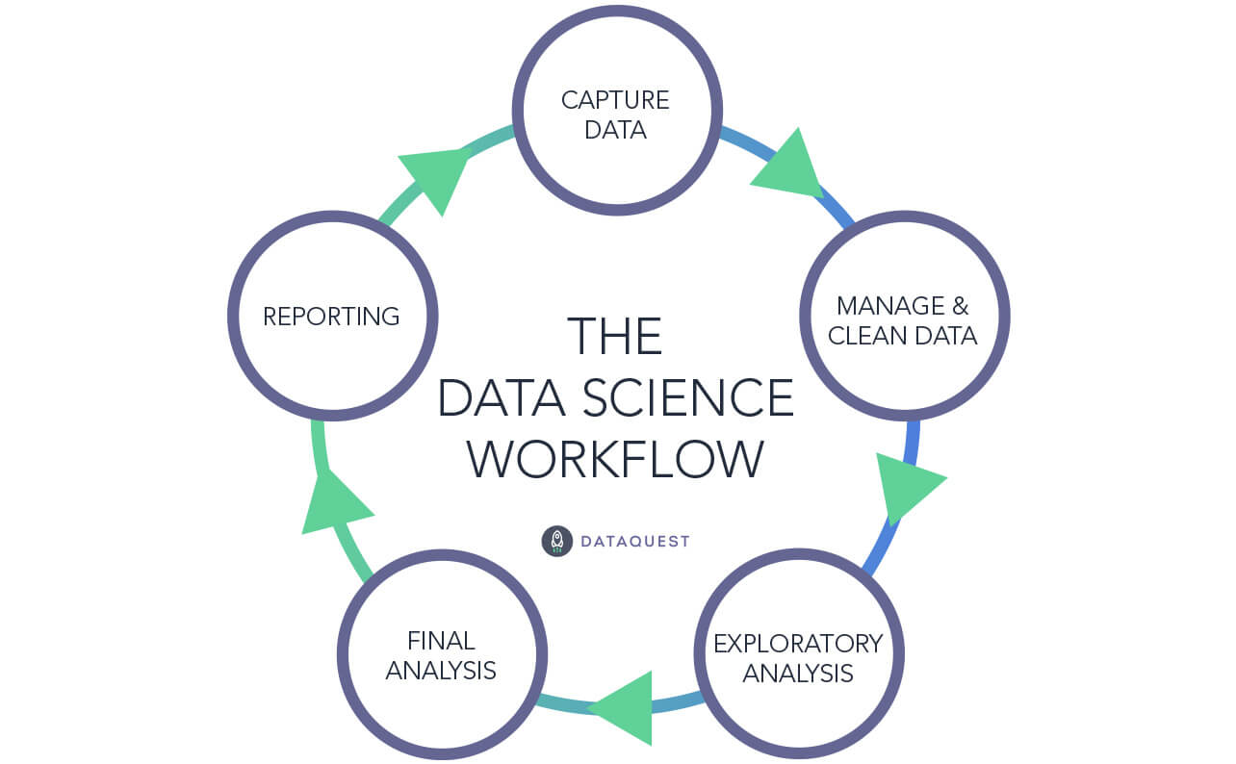
Data Science Lifecycle

Slide 36
Exploratory Data Analysis (EDA)
EDA is applied to explore a data set, which means:
Use methods that help you understand the data:
to help you understand the events that generated the data
detect outliers (e.g. assess data quality
test assumptions (e.g. normal distributions or skewed?)
identify useful raw data & transforms (e.g. log(x))
Before diving into EDA, we need to understand different types of data.

Slide 37
Types of Data I
Categorical (Qualitative)
Nominal scales – number is just a symbol that identifies a quality
0=male, 1=female
1=green, 2=blue, 3=red, 4=white
Ordinal – rank order
Quantitative (continuous and discrete)
Interval – units are of identical size (i.e. Years)
Ratio – distance from an absolute zero (i.e. Age, reaction time)

Slide 38
Quantitative data is a measurement
Every measurement has 2 parts:
The True Score (the actual state of things in the world)
ERROR! (mistakes, bad measurement, report bias, context effects, etc.)
X = T + e
EDA can help identify outliers, etc.

Slide 39
Variable Summaries
Indices of central tendency:
Mean – the average value
Median – the middle value
Mode – the most frequent value
Indices of Variability:
Variance – the spread around the mean
Standard deviation
Standard error of the mean (estimate)
Variable summaries helps us understand the data quickly and detect outliers.
Don’t need to report all of theses: Bottom line…do these numbers make sense???

Slide 40
The Mean
Mean = sum of all scores divided by number of scores
X₁ + X₂ + X₃ + …. X_{n}
n
Is the mean the best summarization of a column?
What potential issues can arise?
Subject | before | during | after
1 | 3 | 2 | 7
2 | 3 | 8 | 4
3 | 3 | 7 | 3
4 | 3 | 2 | 6
5 | 3 | 8 | 4
6 | 3 | 1 | 6
7 | 3 | 9 | 3
8 | 3 | 3 | 6
9 | 3 | 9 | 4
10 | 3 | 1 | 7
Sum = 30 50 50
/n 10 10 10
Mean = 3 5 5

Slide 41
The Mean
Subject | before | during | after
1 | 3 | 2 | 1000
2 | 3 | 8 | 4
3 | 3 | 7 | 3
4 | 3 | 2 | 6
5 | 3 | 8 | 4
6 | 3 | 1 | 6
7 | 3 | 9 | 3
8 | 3 | 3 | 6
9 | 3 | 9 | 4
10 | 3 | 1 | 7
One value ( possibly an outlier) can influence the mean.
In this case, the median could be a better summary.
Sum = 30 50 1043
/n 10 10 10
Mean = 3 5 104.3

Slide 42
The Variance: Sum of the squared deviations divided by number of scores
Subject | before | during | after
1 | 3 | 2 | 7
2 | 3 | 8 | 4
3 | 3 | 7 | 3
4 | 3 | 2 | 6
5 | 3 | 8 | 4
6 | 3 | 1 | 6
7 | 3 | 9 | 3
8 | 3 | 3 | 6
9 | 3 | 9 | 4
10 | 3 | 1 | 7
Before -mean | Before – mean ² | During - mean | During – mean² | After - mean | After – mean ²
0 | 0 | -3 | 9 | 2 | 4
0 | 0 | 3 | 9 | -1 | 1
0 | 0 | 2 | 4 | -2 | 4
0 | 0 | -3 | 9 | 1 | 1
0 | 0 | 3 | 9 | -1 | 1
0 | 0 | -4 | 16 | 1 | 1
0 | 0 | 4 | 16 | -2 | 4
0 | 0 | -2 | 4 | 1 | 1
0 | 0 | 4 | 16 | -1 | 1
0 | 0 | -4 | 16 | 2 | 4
Sum = 30 50 50
/n 10 10 10
Mean = 3 5 5
0 0 0 108 0 22
10* 10 10
VAR = 0 10.8 2.2
*actually you divide by n-1 because it is a sample and not a population, but you get the idea…

Slide 43
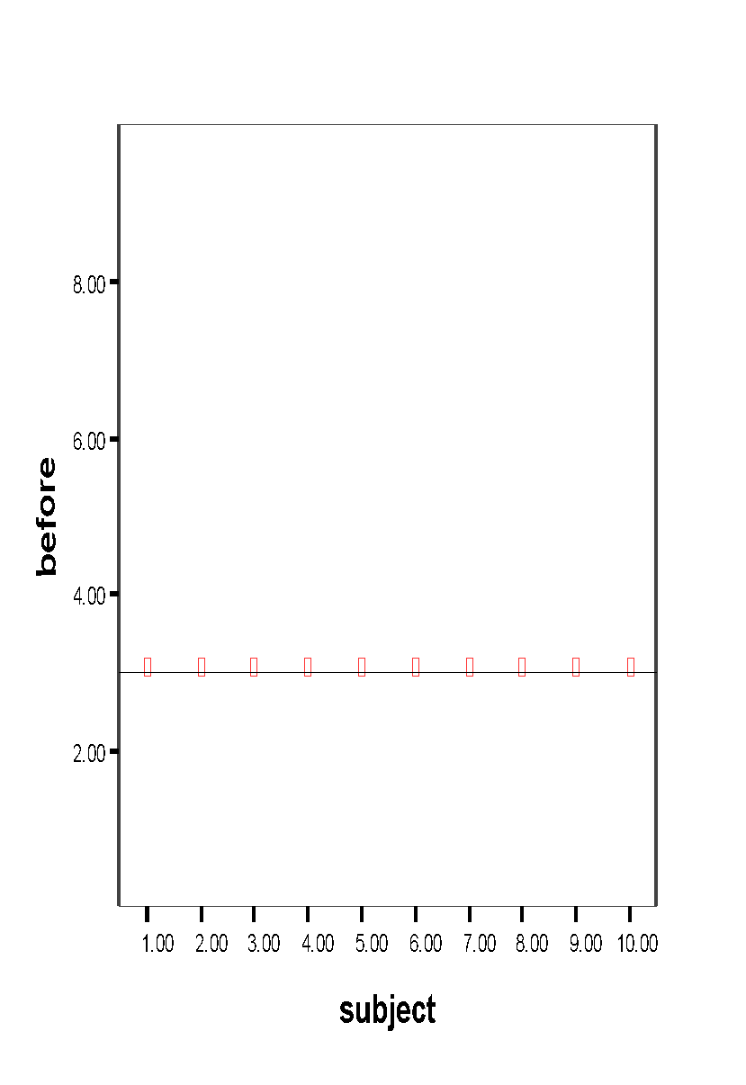
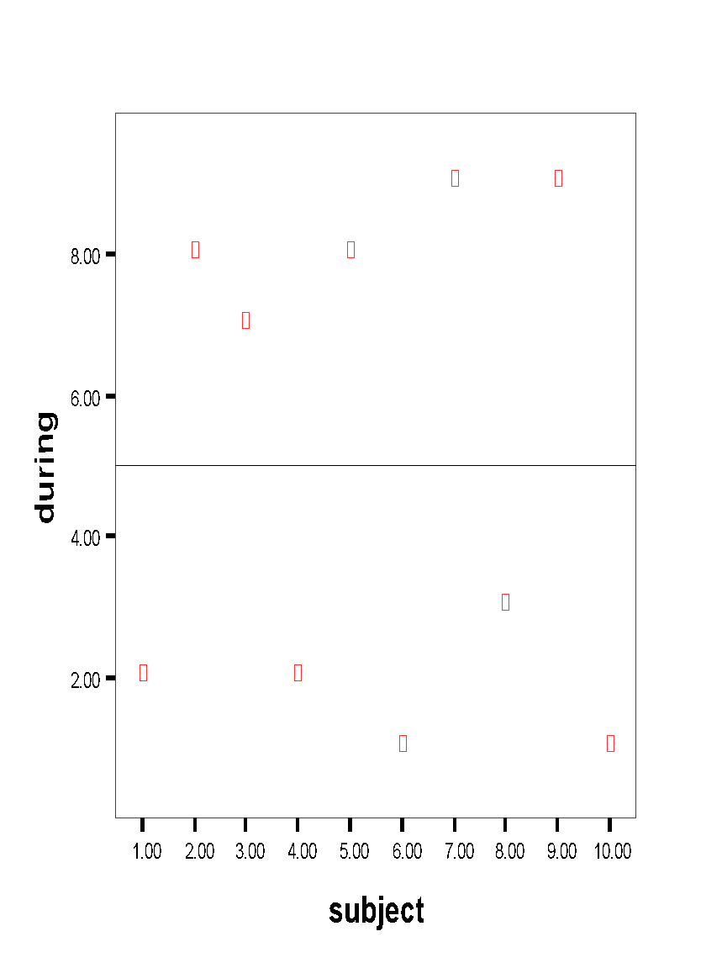
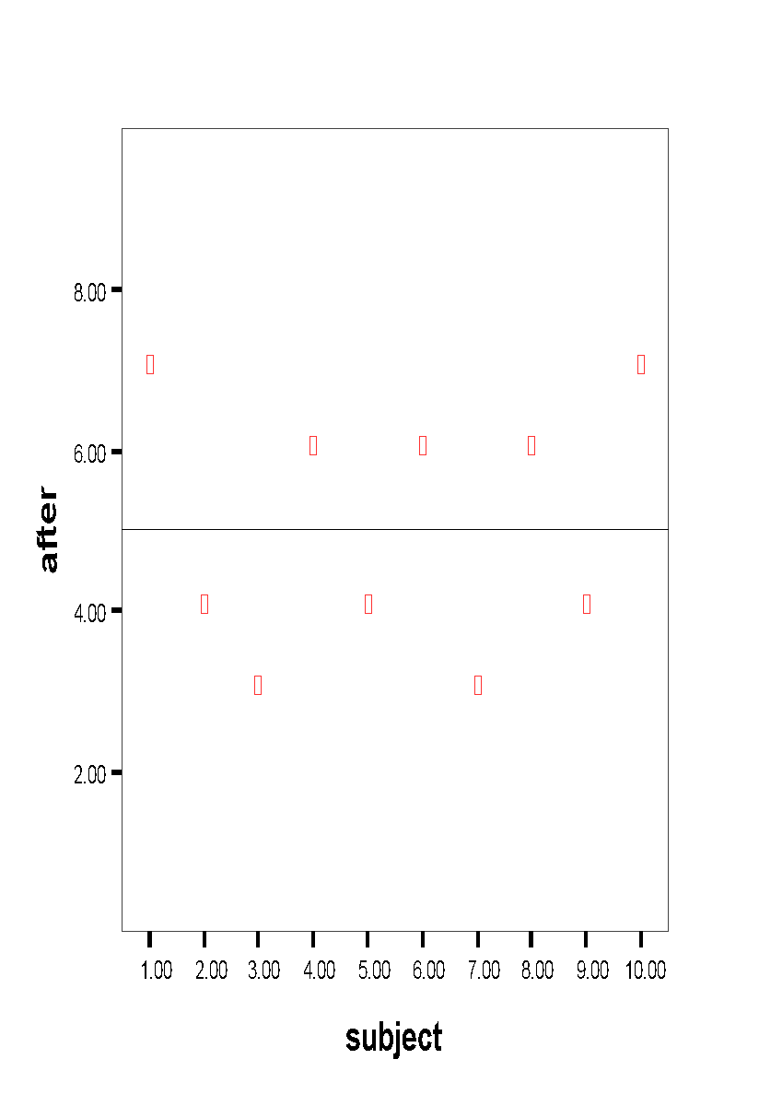
Variance continued
mean

Slide 44
Standard deviation
Variance, as calculated earlier, is arbitrary.
What does it mean to have a variance of 10.8? Or 2.2? Or 1459.092? Or 0.000001?
Nothing. But if you could “standardize” that value, you could talk about any variance (i.e. deviation) in equivalent terms.
Standard Deviations are simply the square root of the variance

Slide 45
Standard deviation
The process of standardizing deviations goes like this:
1. Score (in the units that are meaningful)
2. Mean
3. Each score’s deviation from the mean
4. Square that deviation
5. Sum all the squared deviations (Sum of Squares)
6. Divide by n (if population) or n-1 (if sample)
7. Square root – now the value is in the units we started with!!!
Variance

Slide 46
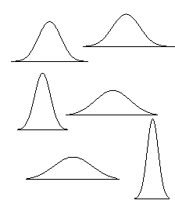
Interpreting standard deviation (SD)
First, the SD will let you know about the distribution of scores around the mean.
High SDs (relative to the mean) indicate the scores are spread out
Low SDs tell you that most scores are very near the mean.
High SD
Low SD

Slide 47
Interpreting standard deviation (SD)
Second, you can then interpret any individual score in terms of the SD.
For example: mean = 50, SD = 10 versus mean = 50, SD = 1
A score of 55 is:
0.5 Standard deviation units from the mean (not much) OR
5 standard deviation units from mean (a lot!)

Slide 48
Standardized scores (Z)
Third, you can use SDs to create standardized scores – that is, force the scores onto a normal distribution by putting each score into units of SD.
Subtract the mean from each score and divide by SD
Z = (X – mean)/SD

Slide 49
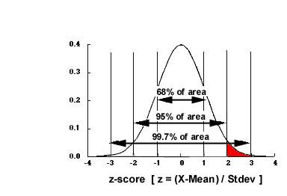
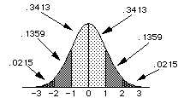
Standardized normal distribution
ALL Z-scores have a mean of 0 and SD of 1. Nice and simple.
From this we can get the proportion of scores anywhere in the distribution.

Slide 50
Summary
Examine every variable for:
Out of range values
Normality
Outliers
Visual display of data is useful as well
Histograms
Stem and Leaf plots
Boxplots
QQ Plots

Slide 51
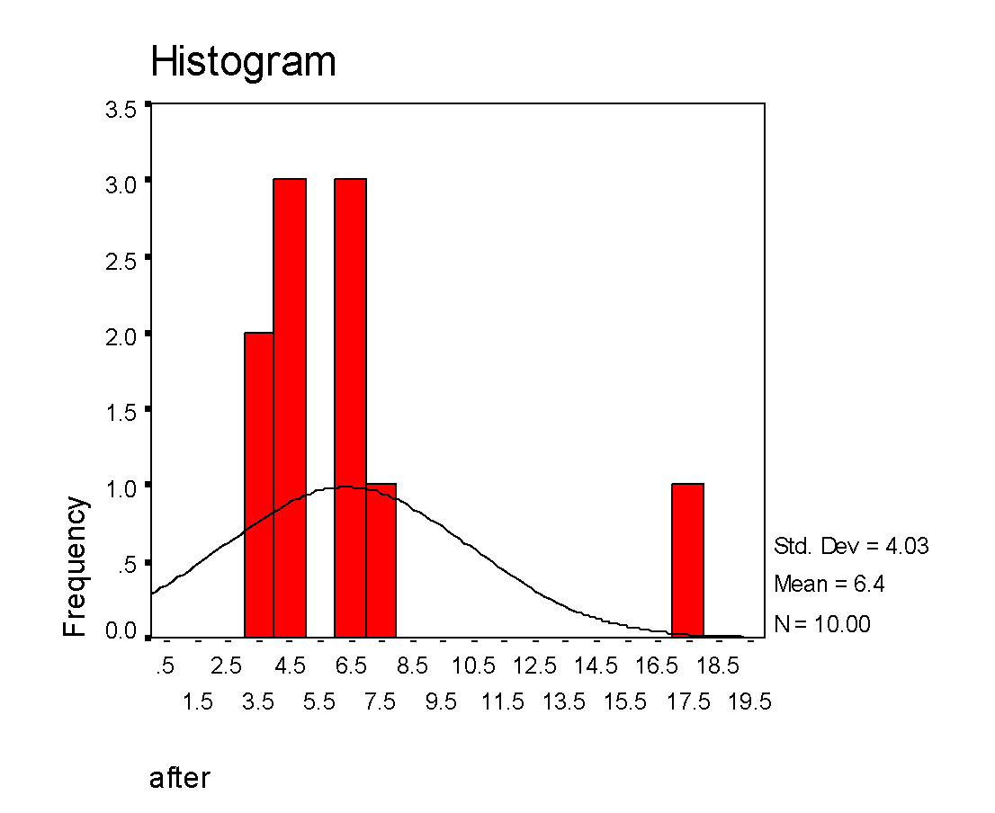
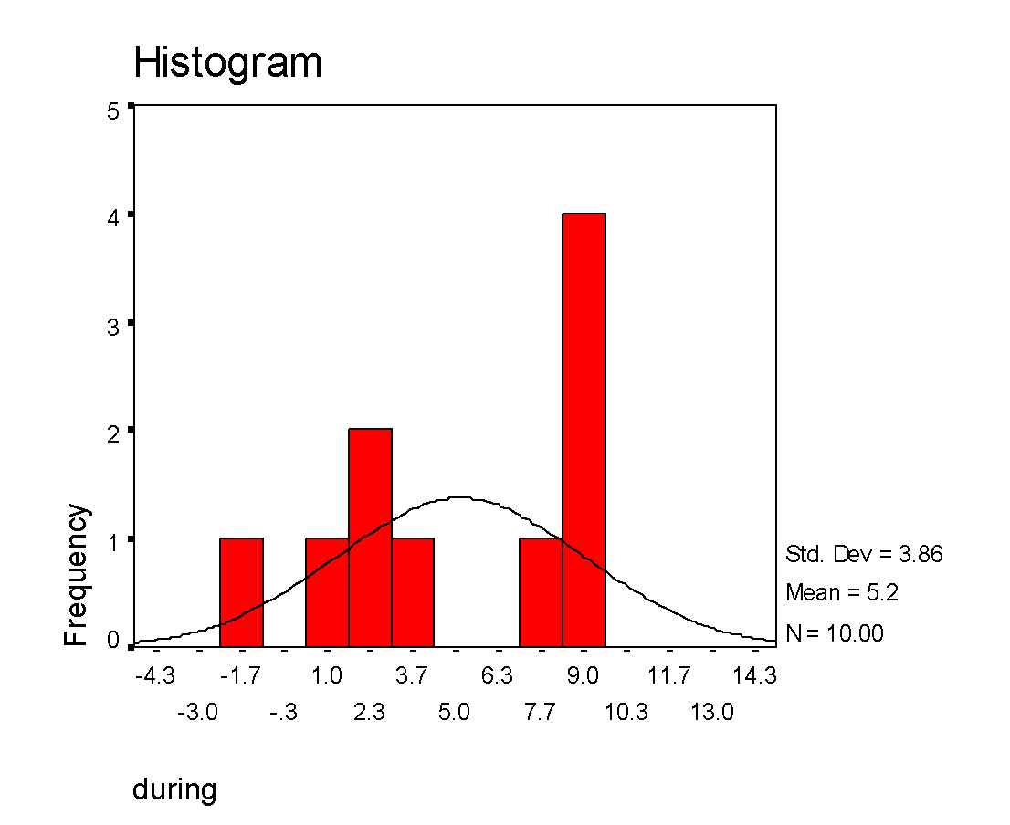
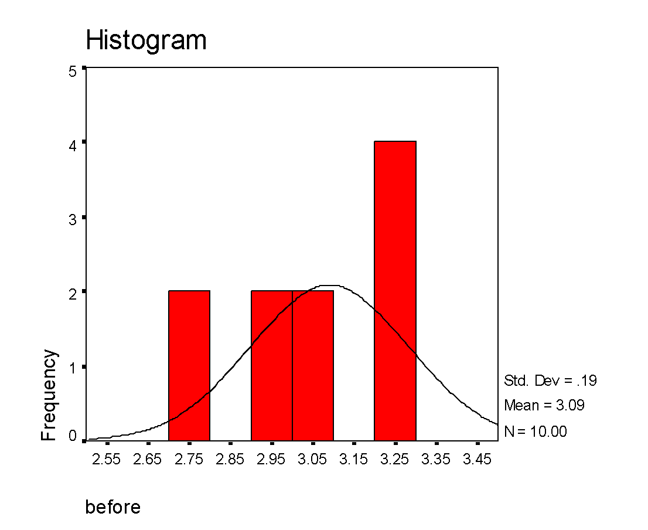
Histograms
# of bins is very important:

Slide 52
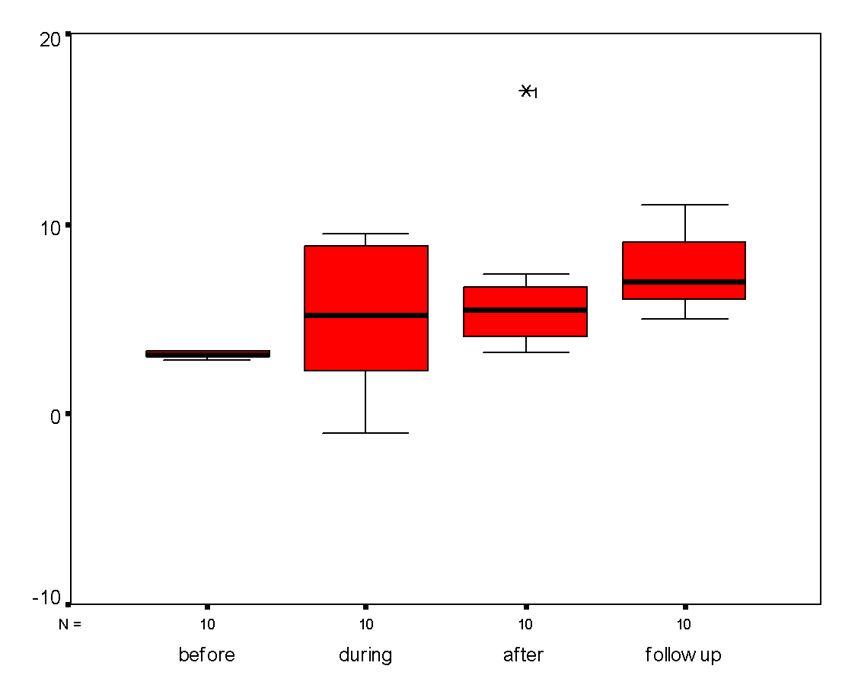
Boxplots
Upper and lower bounds of boxes are the 25th and 75th percentile (interquartile range)
Whiskers are min and max value unless there is an outlier
An outlier is beyond 1.5 times the interquartile range (box length)

Slide 53
So, now what?
If you find a mistake, fix it.
If you find an outlier, trim it or delete it.
Otherwise the outlier will affect your analysis.
If your distributions are askew, transform the data
Positive skew is reduced by using the square root or log
Negative skew is reduced by squaring the data values

Slide 54
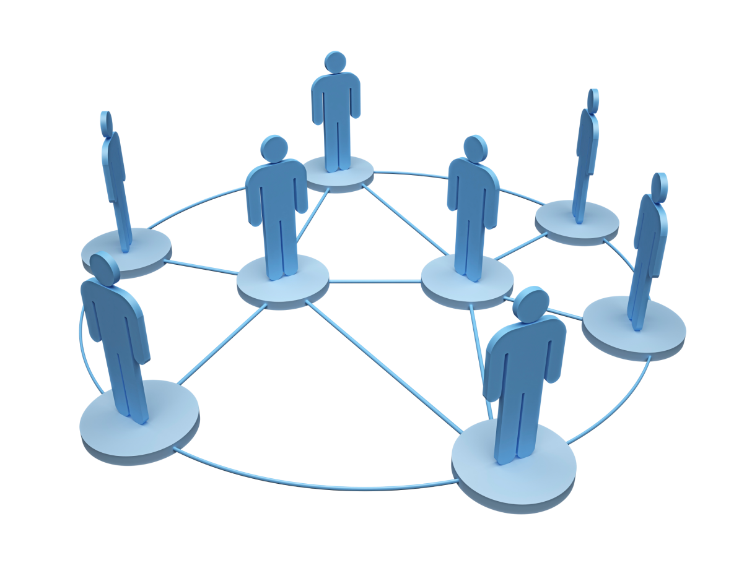
Graph Data
What is a Graph?
A graph is a collection of interconnected nodes.
An “edge” is a connection or tie between two nodes.
A neighborhood N for a vertex or node is the set of its immediately connected nodes.
Degree: The degree k_{i} of a vertex or node is the number of other nodes in its neighborhood.

Slide 55
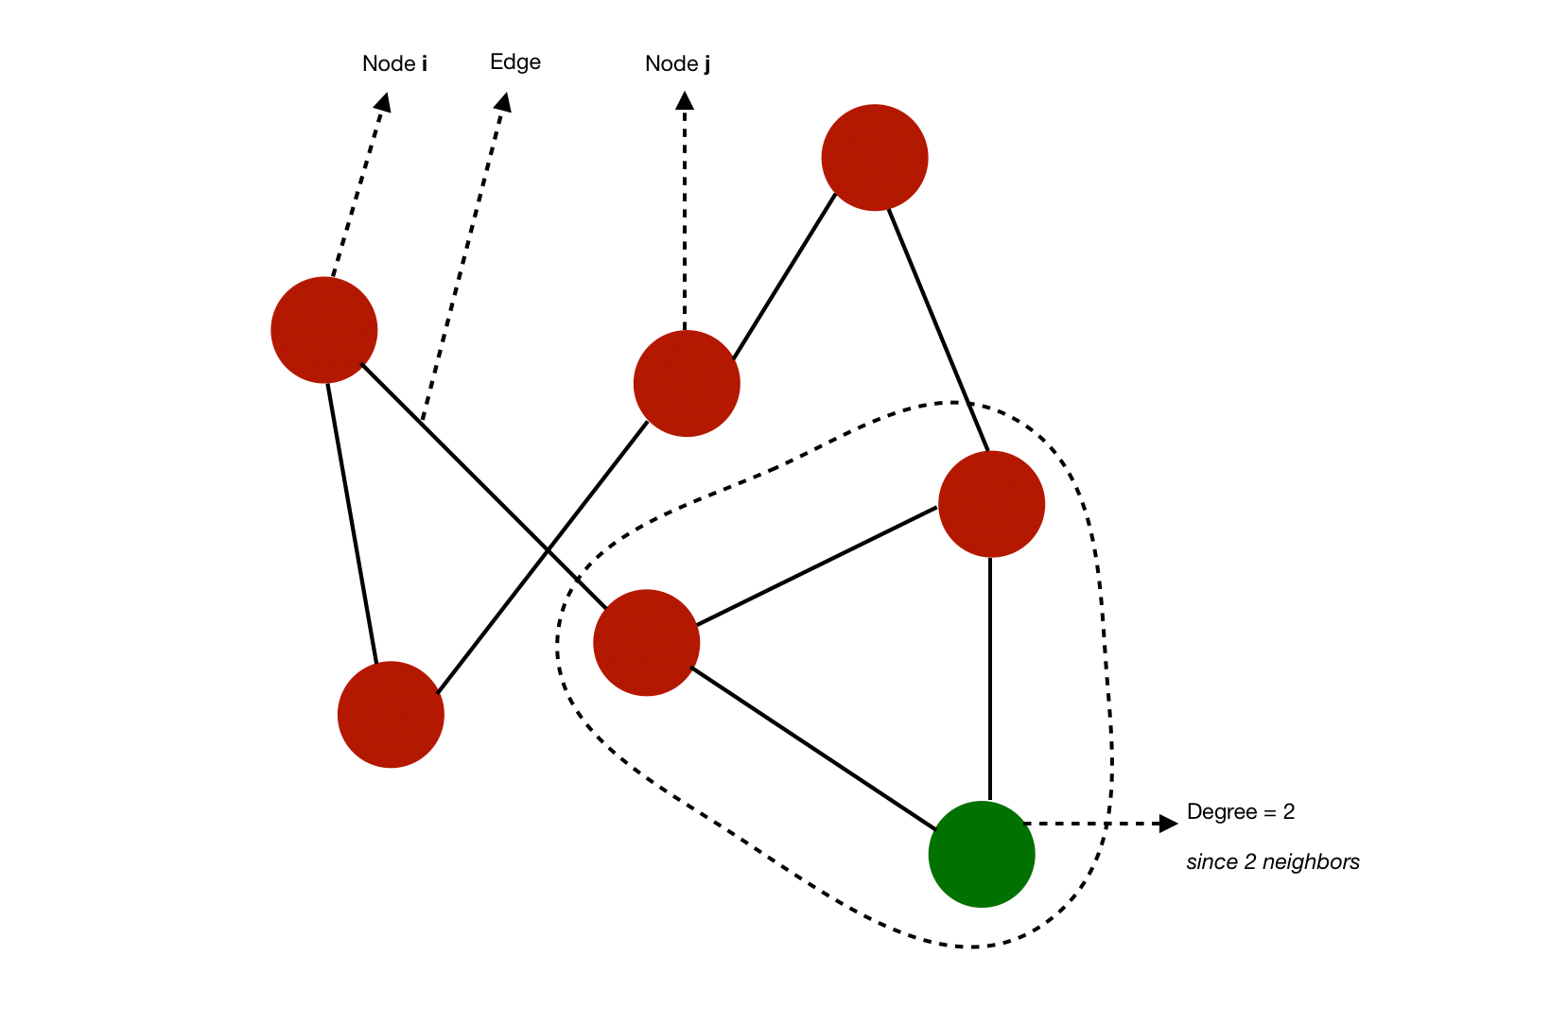
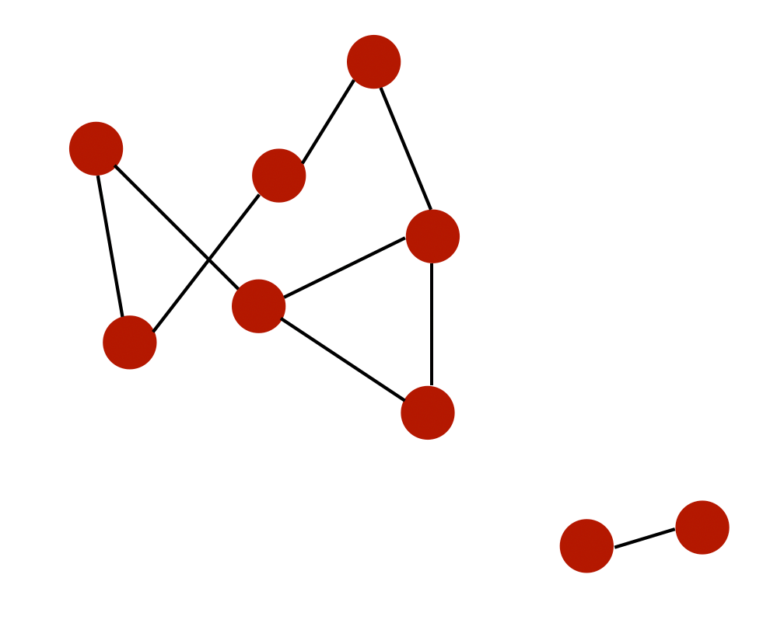
Graph Data (Cont.)
A degree of a node is its number of neighbors
A graph is complete if all nodes have n−1 neighbors. This would mean that all nodes are connected in every possible way.
A path from i to j is a sequence of edges that goes from i to j. This path has a length equal to the number of edges it goes through.
If all the nodes can be reached from each other by a given path, they form a connected component. A graph is connected is it has a single connected component

Slide 56
Types of graphs
Graphs can be used to represent :
social networks
web pages
biological networks
Social networks are essentially graphs
a social structure made up of individuals (or organizations) called "nodes", which are tied (connected) by one or more specific types of interdependency, such as friendship, common interest
Social Network analysis - views social relationships in terms of network theory consisting of nodes and ties (also called edges, links or connections).

Slide 57
Some concepts
What kind of analysis can we perform on a graph?
study topology and connectivity
community detection
identification of central nodes
predict missing nodes
predict missing edges
…

Slide 58
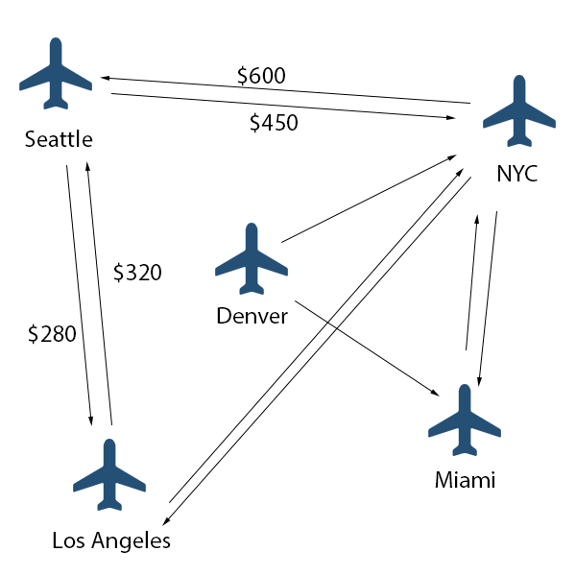
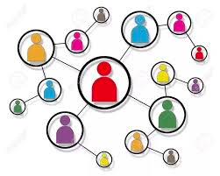
Some concepts
In an undirected graph or network, the edges are reciprocal—so if A is connected to B, B is by definition connected to A.
In a directed graph or network, the edges are not necessarily reciprocal—A may be connected to B, but B may not be connected to A (think of a graph with arrows indicating direction of the edges.)

Slide 59
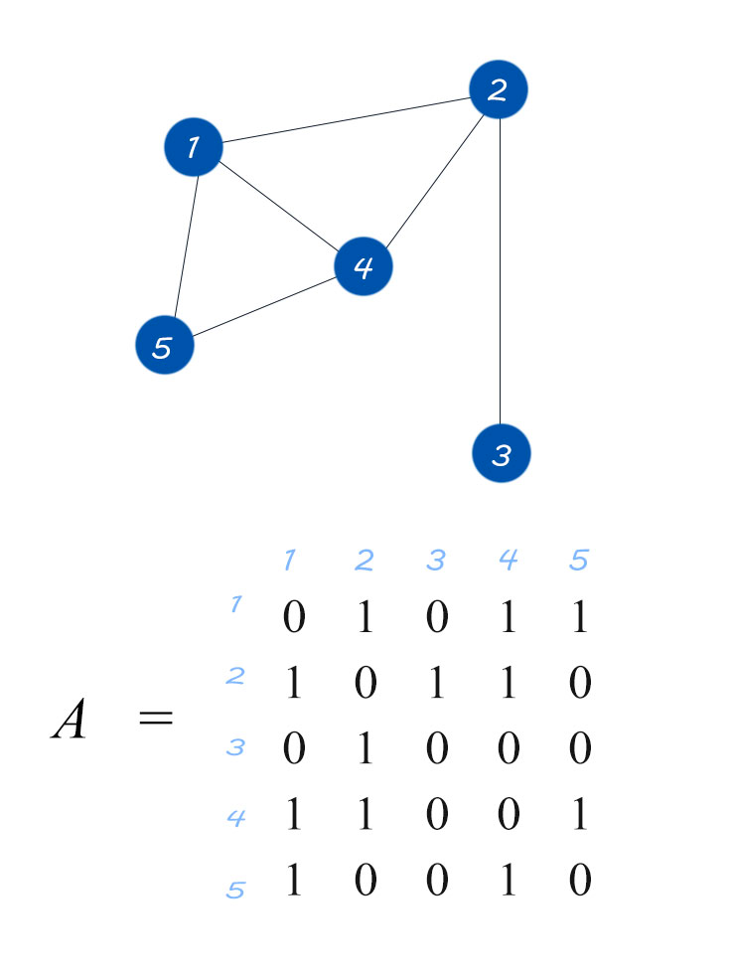
How to represent a graph
A graph can be represented using an adjacency matrix
For each possible pair in the graph, set it to 1 if the 2 nodes are linked by an edge. A is symmetric if the graph is undirected.
The adjacency matrix is sparse, hence we use a efficient representation
Example
1 : [ 2, 3, 4]
2 : [1, 3]
3 : [2, 4]
….

Slide 60
Graph algorithms
There are 3 main categories of graph algorithms that are currently supported in most frameworks (networkx in Python, or in Neo4J for example) :
Pathfinding: identify the optimal path depending on availability and quality for example. We’ll also include search algorithms in this category. This can be used to identify the quickest route or traffic routing for example.
Centrality: determine the importance of the nodes in the network. This can be used to identify influencers in social media for example or identify potential attack targets in a network.
Community detection: evaluate how a group is clustered. This can be used to segment customers and detect fraud for example.

Slide 61
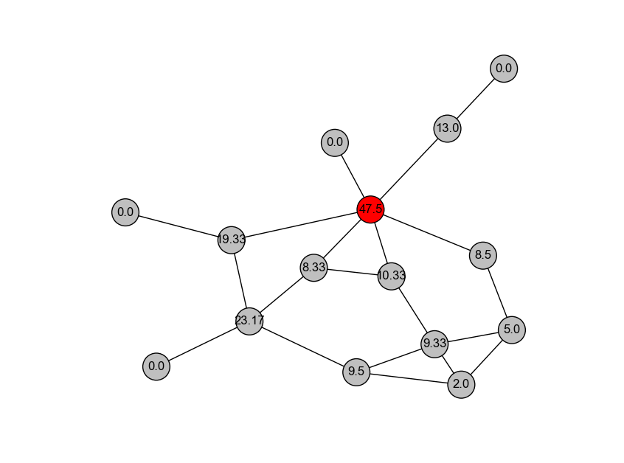
Centrality algorithms
Centrality measures how important a node is.
This is not a clear definition, but it’s useful when we want to identify
important web pages,
Influential users in a social network
bottlenecks in transportation networks…

Slide 62
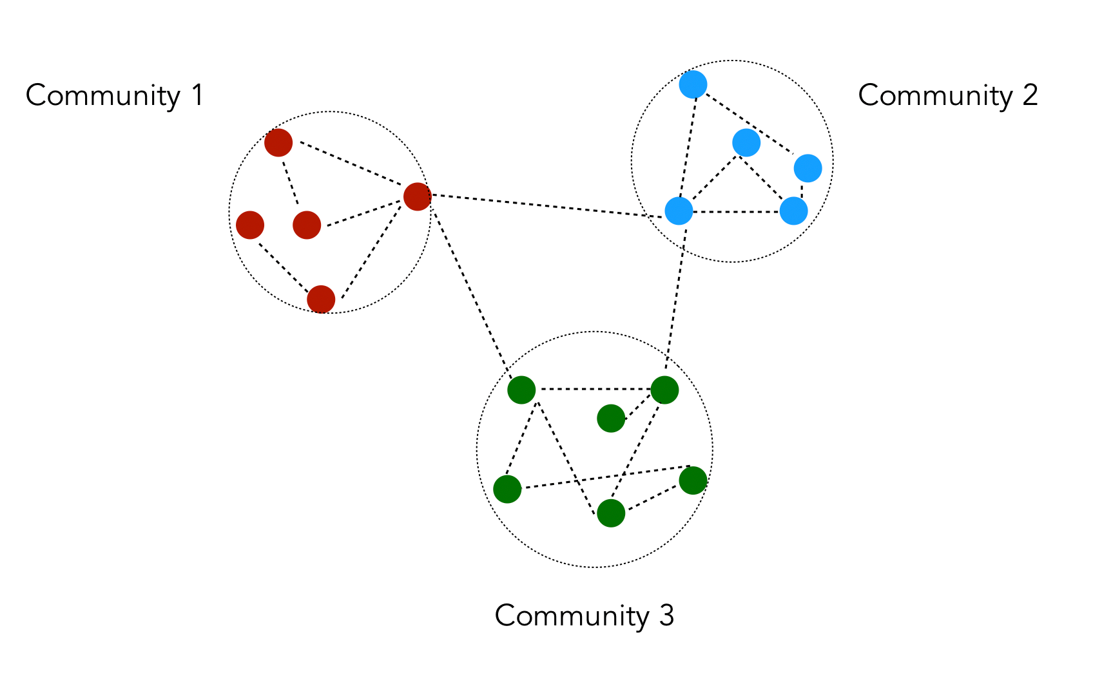
Community Detection
Community detection partitions the nodes into a several groups according to a given quality criterion.
It is typically used to identify social communities, customers behaviors or web pages topics.
A community is a set of connected nodes.

Slide 63
Time Series Data
A time series is a series of data points indexed (or listed or graphed) in time order.
Example of time series
Opening and closing prices of stocks
Measurement of temperature on a daily or hourly basis
Measurement of air quality throughout the year
Objectives of time series analysis
Compact description of the data
interpretation
forecasting

Slide 64


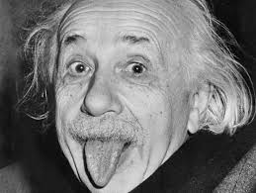
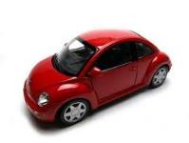






Textual Data
Topics:
People
Events
Products
Services, …
…
Sources:
Blogs
Microblogs
Forums
Reviews ,…
45M reviews
65M msgs/day
4.2 billion likes per day
…

Slide 65
Textual Data Analysis
Category or topic summarization / concept extraction - determining the topic(s) being discussed in a document
Document clustering - grouping and categorizing documents
Natural Language Processing (NLP)- low-level language processing and understanding (tagging part of speech)
Sentiment analysis - understanding the sentiment and object in a body of text
Information extraction - identification and extraction of relevant facts and relationships from unstructured text
Sentence completion / suggestion - auto competition or suggestion of similar questions, replies, etc.

